Slide 1
JW MARRIOTT PHOENIX DESERT RIDGE RESORT & SPA
INSTAGRAM GROWTH STRATEGY

Slide 2

YTD SUCCESS

Slide 3
YTD GROWTH: INSTAGRAM
59%
4,360
11,753
INCREASE IN INSTAGRAM FOLLOWERS
NEW FOLLOWERS GAINED
TOTAL INSTAGRAM FOLLOWERS
198%
79,635
#2
INCREASE IN INSTAGRAM ENGAGEMENT
NEW POST ENGAGEMENTS
OUT OF THE COMPETITIVE SET IN INSTAGRAM NEW ENGAGEMENT

Slide 4
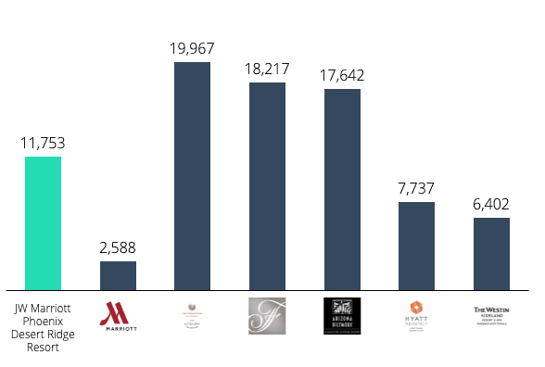
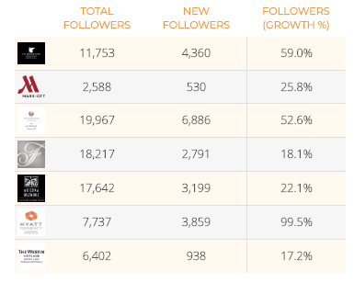
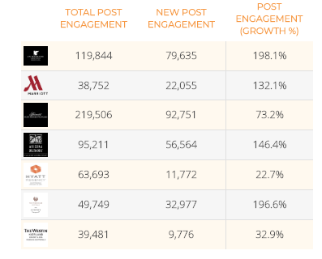
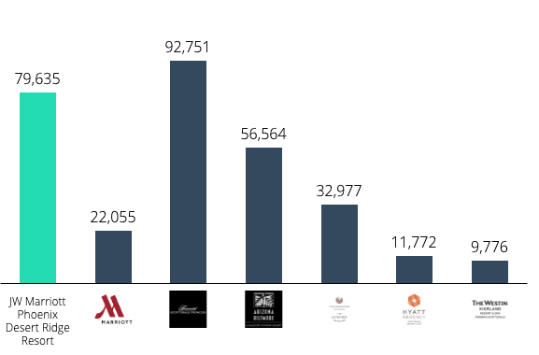
INSTAGRAM COMPETITIVE
TOTAL FOLLOWERS
KEY TAKEAWAYS
The Phoenician has 1.6X more followers than PHXDR, but PHXDR drives 2.4X more engagement
The Biltmore has 1.5X more followers than PHXDR, but PHXDR drives 1.4X more engagement
NEW ENGAGEMENT

Slide 5

INSTAGRAM GIVEAWAY HIGHLIGHTS
OBJECTIVE
Garner new Instagram followers to accelerate strides within the competitive set
STRATEGY
Ran an Instagram Giveaway with the CTA to enter to 1) Follow us on Instagram 2) Comment below and tag a friend
Launched Instagram Story ads that promoted that campaign and directed users to our Instagram post
Utilized video captured by BCV team on property with the Instagram Story ads to leverage video prioritization and capture user attention
RESULTS
The Instagram post announcing the giveaway garnered 12,850 likes & 2,204 comments
During the giveaway time period of one month, we increased the Instagram community size by 17%,gaining 1,447 new followers
The post drove 50X more likes compared to an average Instagram post on the page and 11X more comments

Slide 6

INSTAGRAM STORIES | AD CAMPAIGN
OBJECTIVE
RESULTS
Increase Instagram community size by driving more users to our Instagram channel
Instagram Story ads had a reach of 80,000 people, driving 140,000+ impressions
Ads drove over 1,000 link clicks to our Instagram profile
Of the IG Story Ads with video, 2,100+ users watched at least 75% of the video before taking action or leaving
The ad iterations with video drove close to 8,000 video views
STRATEGY
Capitalize on the 500+ million accounts using Instagram Stories to direct users back to our Instagram Profile
Utilize full screen, vertical format ads served via Instagram Stories to share photos and videos that immerse Instagrammers in JW Marriott Phoenix Desert Ridge Resort & Spa content & drive them to our Instagram profile
Each ad iteration (4 total iterations) will have a swipe up feature at the end to take the user to our Instagram Profile, with the CTA to follow us for more

Slide 7

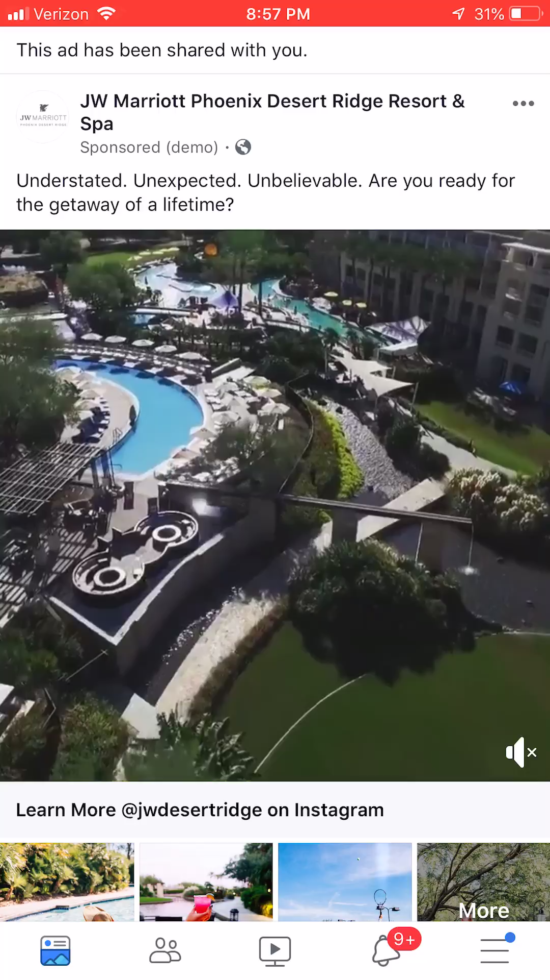
INSTAGRAM COLLECTION | AD CAMPAIGN
OBJECTIVE
STRATEGY & TACTICS
Increase Instagram community size by driving more users to our Instagram channel
In order to tell JW Marriott Phoenix Desert Ridge Resort & Spa’s unique stor, we utilized an integrated ad type, which includes photo, video & carousel ad formats, in one cohesive experience.
All links within the ad drive to the Instagram channel, with direct CTA to follow us on Instagram @jwdesertridge for more
The ads drove 8,800+ users to our Instagram Profile, reaching close to 200,000 people and drove 330,000 impressions
Of the 8,800 link clicks, 7,000 were unique link clicks
The ads received close to 100,000 views
AUDIENCE TARGETING
Social media fans, past & current guests
Key feeder markets
Fans of competitor pages
Luxury travelers, family travelers, frequent travelers, adventure travelers, etc.
WHY WE LOVE IT
With majority of social media users on mobile, capitalizes on a mobile-first ad type to capture users in the discovery stage
Utilizing Collection Ad format provides an immersive way for users to move from discovery to action smoothly
CLICK TO PLAY
CLICK TO PLAY

Slide 8
RISKS & LIMITATIONS OF BUYING FOLLOWERS

Slide 9
LIMITATIONS & RISKS
FIVE PRIMARY REASONS WE DO NOT RECOMMEND BUYING FOLLOWERS:
(1) Buying followers goes against Instagram Terms of Use & Community Guidelines
(2) Instagram does now allow use of ‘follower farms’ or ‘buying followers’, and has been taking active
steps to block accounts that are using any third party sites to block followers
(3) In effort to stop this, Instagram has implemented a policy where accounts that have taken too
many actions on the platform (i.e. mass following) will be blocked
(4) If you buy fake followers, we are wasting our advertising budget. We are pay for ad placements to
get in front of the right audience; including our own social media audience. If we have fake
followers, we are pouring money into getting our message in front of bots, not humans. Humans are
the users that make purchases, increase business, enforce brand reputation, and enforce brand
authenticity
(5) Buying followers decreases actual guest’s likelihood of respecting your brand

Slide 10
OFFICIAL STATEMENT FROM INSTAGRAM
The official statement from the Instagram team
We noticed that many profile owners in our social network use third-party applications. They allow you to artificially quickly increase the audience. Millions of people go to Instagram every day to get some real experience. We only wish that fake activity doesn't interfere with this.
Our development team has created special tools that work on the principle of machine learning. From now on, all fake likes, comments, and subscriptions will be deleted. Cheating seriously harms the community. In addition, third-party applications violate:
  Terms of use.
  Community guidelines.
The most serious measures will be taken to limit such behavior. If we catch account holders using such services, we will send a message immediately. It will say that all unnatural likes and comments have been removed. Remember: third-party applications reduce your account security.
We also know that some users unknowingly provide their data to third-party applications. You only need to change the password in order not to lose anything.

Slide 11
ARTICLES & REFERENCES
BUYING INSTAGRAM LIKES & FOLLOWERS HURTS YOUR BRAND
  Gaming the system can actually decrease your engagement and destroy your reputation by creating a spammy presence that makes a bad impression of would-be followers and potential customers.
RISK OF ACCOUNT GETTING BLOCKED
  We are now limited to a certain number of actions on the platform, without getting blocked by Instagram.
  The reason why Instagram is doing this is to identify and regulate the use of bots and reduce spam but many innocent users have been temporarily flag by engaging on penalized acts by Instagram.
INSTAGRAM CRACKING DOWN ON FAKE ACTIVITY: INSTAGRAM STORY VIEWS
  A new growth hacking tactic involves accounts paying third parties to try to boost their profile via the medium of fake likes, followers and comments. Some of these growth hackers probably have banks of phones set up where Instagram Stories are ‘watched’ without being watched. (Which obviously isn’t idea for the Instagram Story Ads we run).
  Instagram confirmed they are attempting to crack down and get rid of this inauthentic activity
INSTAGRAM PURGES BOTS & FAKE ACCOUNTS TO ENSURE USERS FOLLOW CHANNEL TERMS OF USE
  Instagram is removing people’s accounts who use third-party apps for inauthentic follows, Likes and comments that violate its policies; sending them a warning to change their password to cut ties with these apps, and saying people who continue using these apps “may see their Instagram experience impacted.” Instagram states it “may limit access to certain features, for example” for those users.
INSTAGRAM PUTTING A STOP TO LIKE & FOLLOWER FARMS
  From Instagram: "Using these apps goes against our [terms and conditions], and continuing to do so may result in your account being further impacted.”
INSTAGRAM TERMINATING ACCOUNTS THAT USE THIRD-PARTY APPLICATIONS TO BUY FOLLOWERS
  Instagram creators launched an active campaign to combat fake accounts. They will find profiles that use cheating services for promotion. Firstly, the account owner will receive a warning. After that, he is strongly advised to change the password. As a result, special services will be useless over time and will be forced to massively close.

Slide 12
ADDITIONAL
HEALTHY STRATEGIES TO EXPEDITE GROWTH

Slide 13
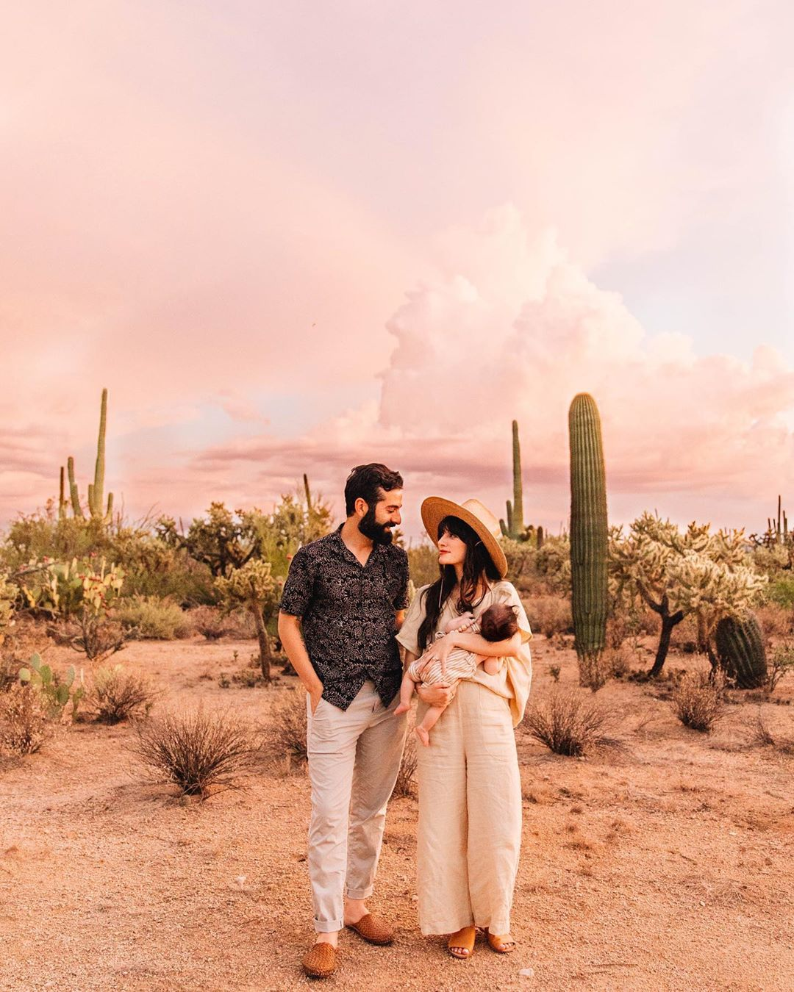
INFLUENCER |GIVEAWAY CAMPAIGN
OBJECTIVE
STRATEGY & TACTICS
Exponentially increase Instagram community size in a short period of time
Partner with travel/lifestyle influencers to run giveaways through the end of the year (dependent on resort capabilities), which include following the resort on Instagram as a requirement to enter
We recommend partnering with 2-3 influencers for the remainder of the year that align well with the property brand to capitalize on their followers, attract highlight relevant potential guests to our channel and drive a spike in our community size
WHY WE LOVE IT
By partnering with an Influencer that aligns with the brand, we gain followers quickly that are actually likely to turn into guests & brand advocates
As running giveaways now goes against the JW Brand standards, this is a healthy & effective workaround
By partnering with several influencers, we build off momentum from previous influencers & continue to gain followers in a short period of time

Slide 14
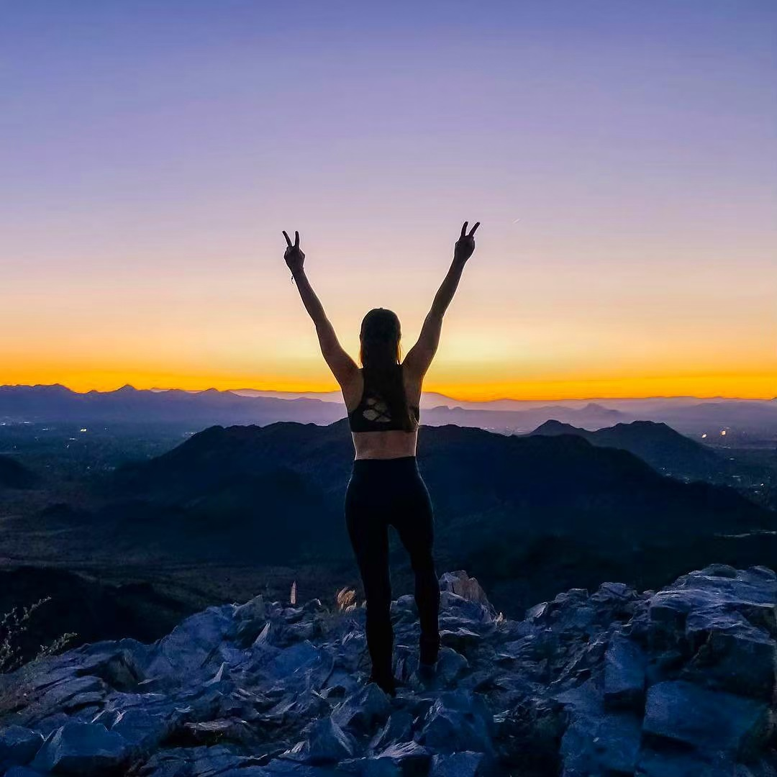
LOCAL PARTNERS | CAMPAIGN
OBJECTIVE
STRATEGY & TACTICS
Utilize local partners to run a cross-promotion campaign to capitalize on their community & drive new followers to our Instagram account
Partner with @VisitPhoenix to run a cross-promotional campaign, where @VisitPhoenix agrees to post about the resort 1-2X per month, and we will do the same
Or, partner with @VisitPhoenix (or another local partner) to do a giveaway to offer an exclusive experience in the destination, followed by a two-night stay at the resort. A requirement to enter is to follow both the resort @jwdesertridge & @VisitPhoenix
  *Potential to turn into an evergreen/ongoing campaign to continuously gain followers & cross-promote with local partners
WHY WE LOVE IT
By cross-promoting with local partner, we get the resort name in front of a highly-relevant audience
We capitalize on our local partners’ audience size & drive their followers to our account, while also establishing the resort as an authority in the local market

